Slide 1

Digital Image Processing Lab Project Presentation
OCR : Optical Character Recognition

Slide 2

Presenting to:
Dr. Md. Zulfiker Mahmud
Professor
Department of Computer Science & Engineering
Jagannath University

Slide 3
Presenting by:
Ankon Karmokar
ID : B190305039
Department of Computer Science & Engineering
Jagannath University

Slide 4
Outline :
Introduction
Applications
Libraries & Tools
Methodology
Steps
Influence of Project
Challenges
Conclusion

Slide 5

Introduction :
Our project (Optical Character Recognition) focuses on developing systems that convert images of text into editable and searchable digital formats. It automates text extraction from various sources, such as scanned documents or handwritten notes, improving data accessibility and processing.

Slide 6

Applications :
Document Digitization
Invoice and Receipt Processing
Historical Document Preservation
License Plate Recognition (LPR)

Slide 7



Libraries & Tools :
Python
Tesseract
VS Code

Slide 8
Methodology :
Image Acquisition
Preprocessing
Segmentation
Output Generation
Classification and Recognition
Feature Extraction

Slide 9
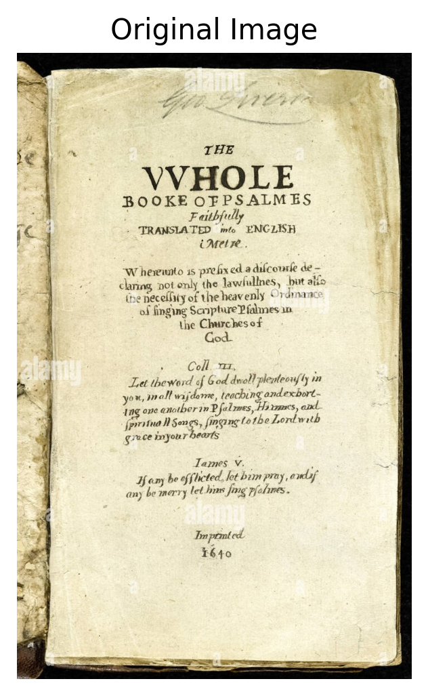
Step 1 : Image Acquisition
The system can handle static images.

Slide 10
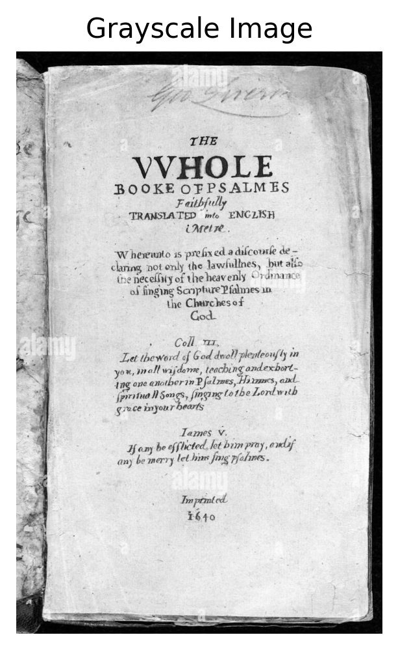
Step 2 : Gray Scaling
Grayscale converts color images into shades of gray, using a single intensity value per pixel, simplifying processing by removing color information while preserving brightness and structure for analysis.

Slide 11
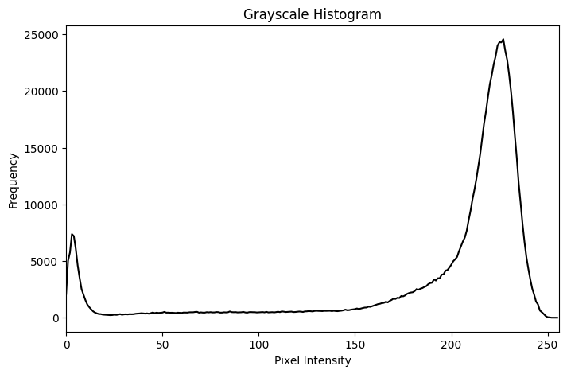
Step 3 : Histogram
Histogram shows the frequency of each intensity level from 0 (black) to 255 (white) in grayscale image.

Slide 12
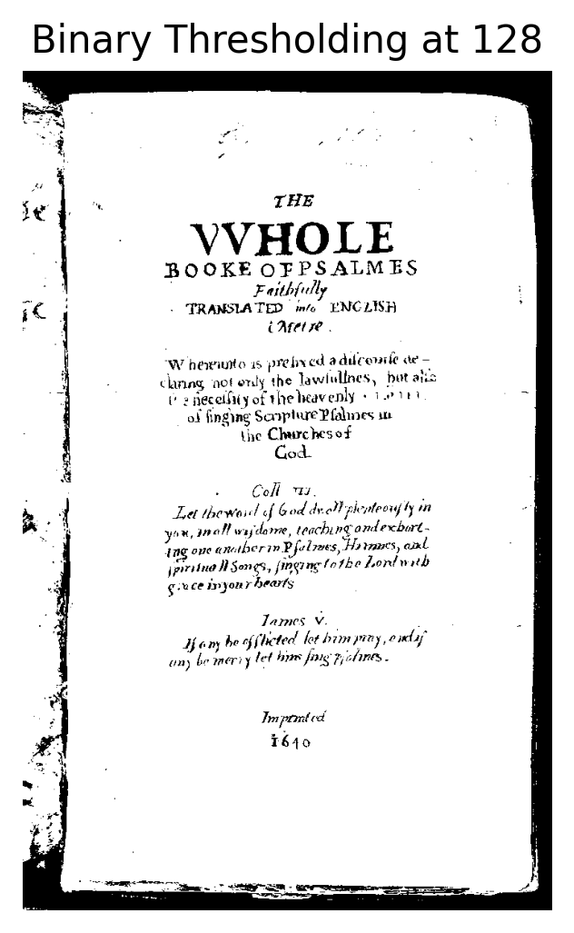
Step 4 : Thresholding
Thresholding is an image segmentation technique that converts grayscale images to binary by setting pixel values above a specified threshold to white and those below to black.

Slide 13
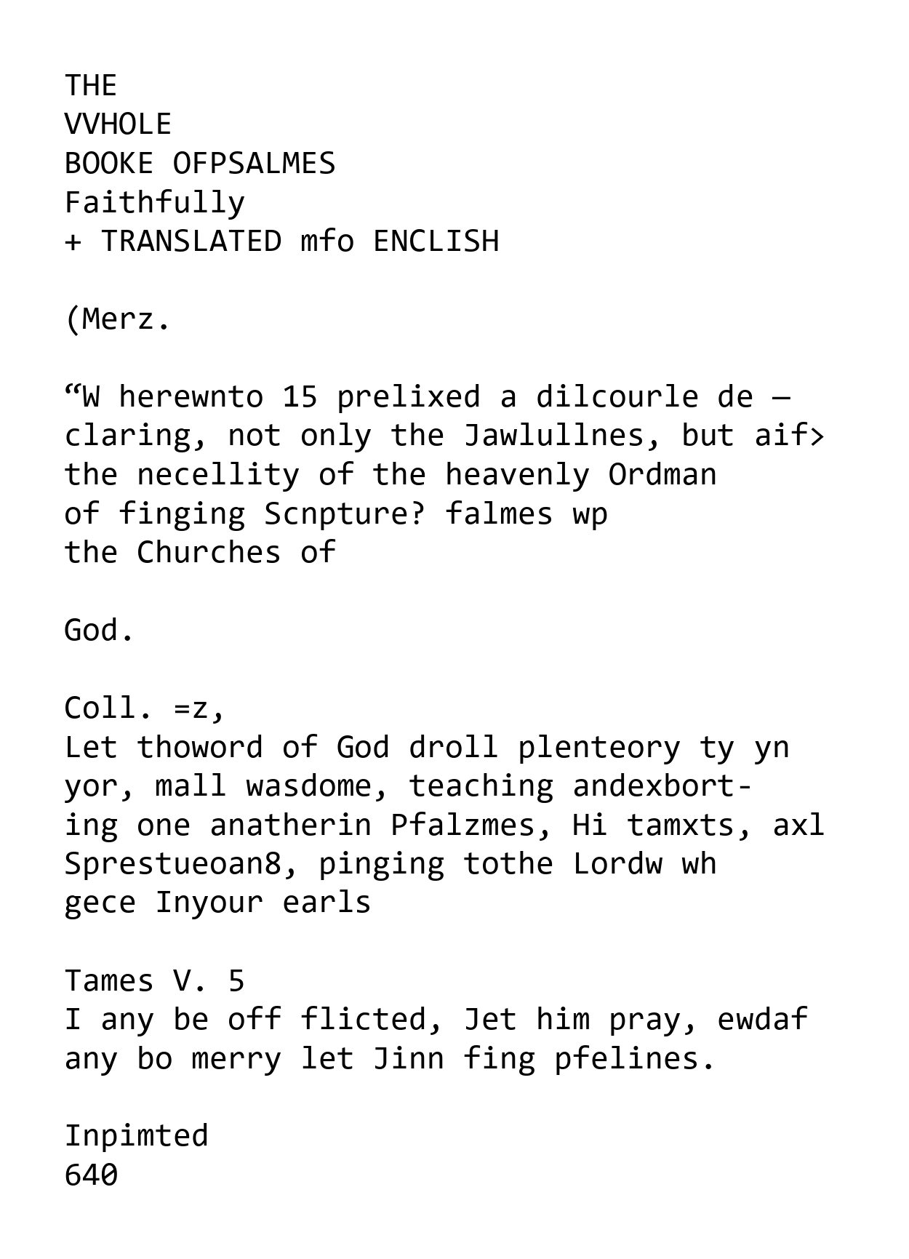
Step 5 : OCR
Finally, the text is extracted from the image using Optical Character Recognition (OCR) techniques.

Slide 14
Influence of Project :
Cost and Time Savings
Improved Document Management
Data Analytics and Processing
Scalability

Slide 15
Challenges :
Low-Quality Images
Complex Layouts and Formatting
Distorted or Rotated Text
Background Noise and Image Artifacts
Limited Contextual Understanding

Slide 16
Conclusion :
Efficiency Gains
Enhanced Accessibility
Improved Document Management
Challenges Addressed
Broad Applicability

Slide 17

Implementation Video :

Slide 18
Any Question ?

Slide 19
Thank You

